Slide 1
TEAM 4
SACHIN GUPTA
ROHAN UNNI
KAMAL DAS
NIKHIL WARWADEKAR

Slide 2
PROBLEM STATEMENT
Predict the probability of weather and ad will get
CLICKED or NOT
A leading affiliate network company from Europe wants to leverage machine learning to improve
(optimise) their conversion rates and eventually their top-line.
The company wants to improve their CPC (cost per click) performance.
A future insight about an ad performance will give them enough head start to make changes (if necessary) in their upcoming CPC campaigns.
They want to reach to audience which doesn’t exist in their marketing reach.

Slide 3
DATA SET
Range Index: 12137810 entries,
OR
0 to 12137809
Reduced the working to 100000 entries

Slide 4
PROBLEM/s with the Data set itself
Total missing values per row
devid 74870
siteid 50040
browserid 24943
Click 0
countrycode 0
merchant 0
Category 0
offerid 0
datetime 0
ID 0
Percent
14.9740
10.0080
4.9886
0.00
0.00
0.00
0.00
0.00
0.00
0.00
Data columns (total 10 columns):
ID object
datetime object
siteid float64
offerid int64
category int64
merchant int64
countrycode object
browserid object
devid object
click int64

Slide 5
E.D.A

Slide 6
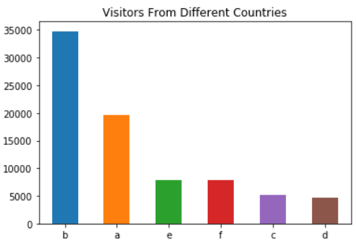
Visitors from different (undisclosed) countries
Country ‘a’ and country ‘b’ has highest traffic

Slide 7
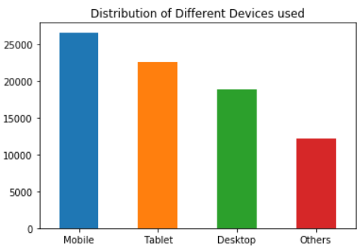
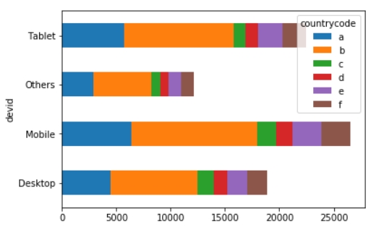
Distribution of devices
Mobile browsing seems to be widely preferred

Slide 8
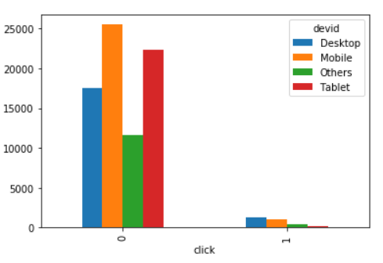
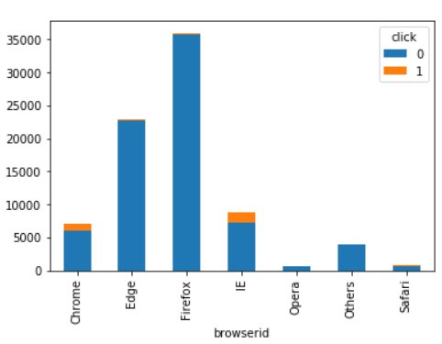
Adclick Analysis
Predominantly used browsers are
Firefox and Edge

Slide 9
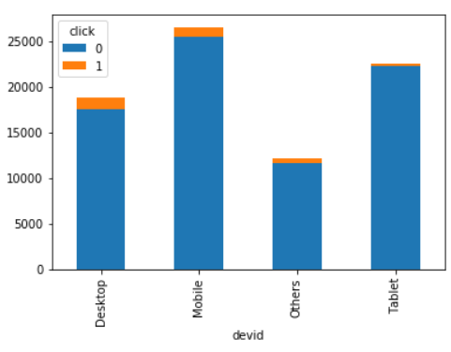
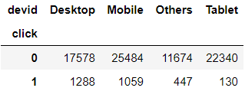
Ad-click Device based Analysis

Slide 10
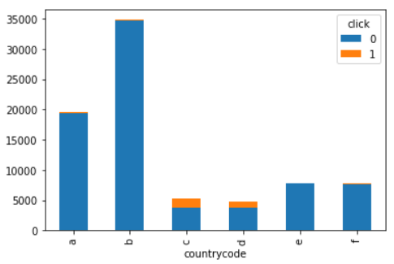
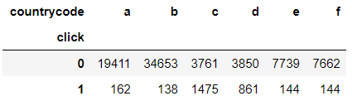
Ad-click Country based Analysis

Slide 11
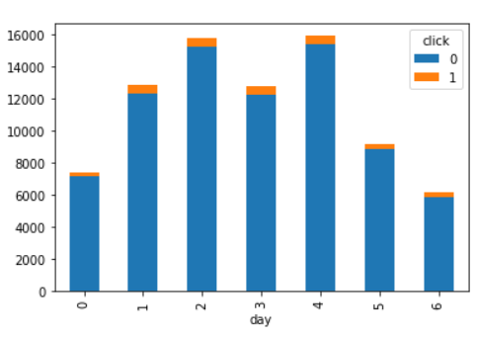
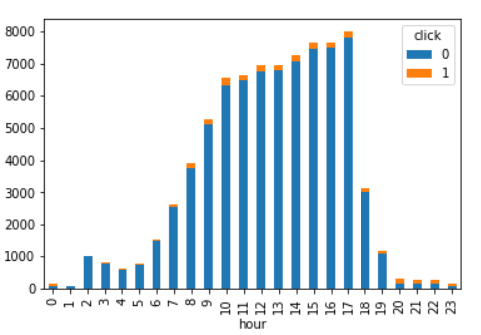
Ad-click Time based Analysis

Slide 12
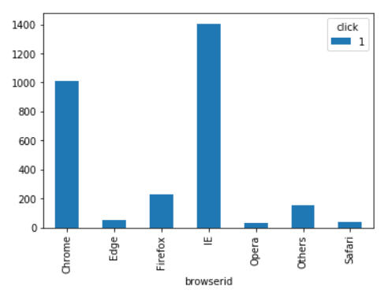
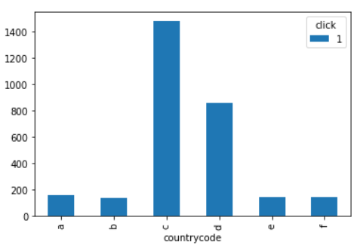
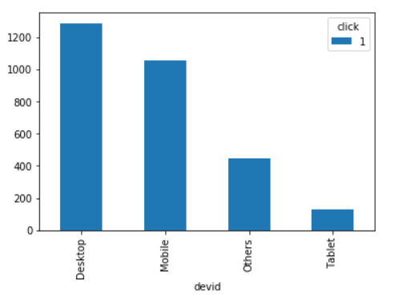
Click based Outcome

Slide 13
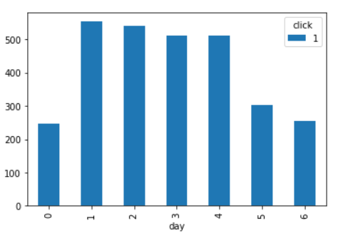
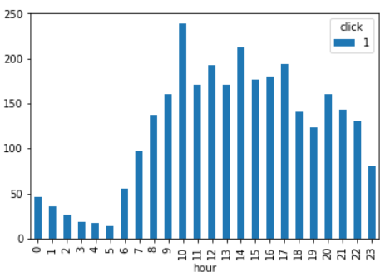
Click based Outcome (cont’d)

Slide 14
MODEL BUILDING

Slide 15
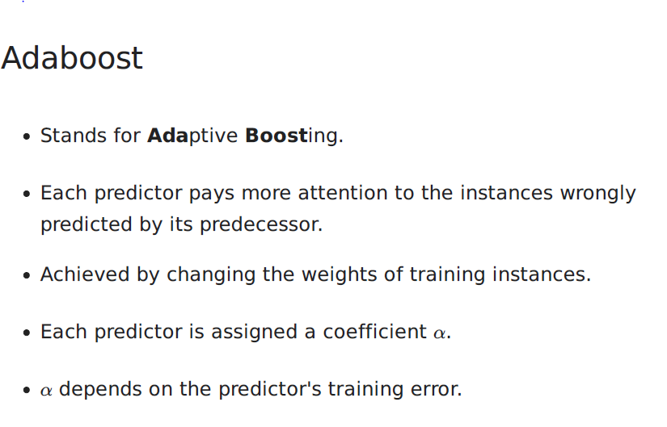

Slide 16
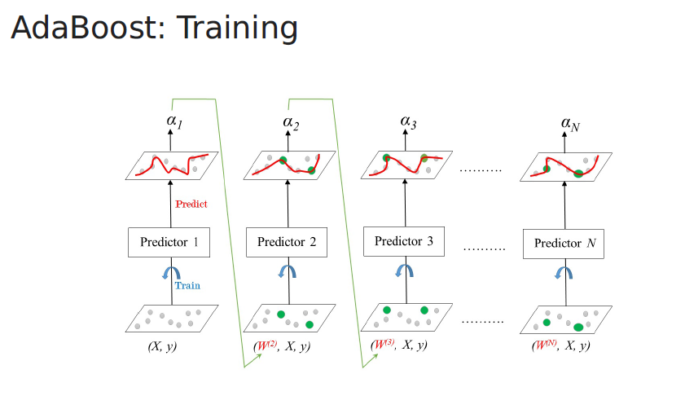
Working of AdaBoost

Slide 17
CONCLUSION

Slide 18
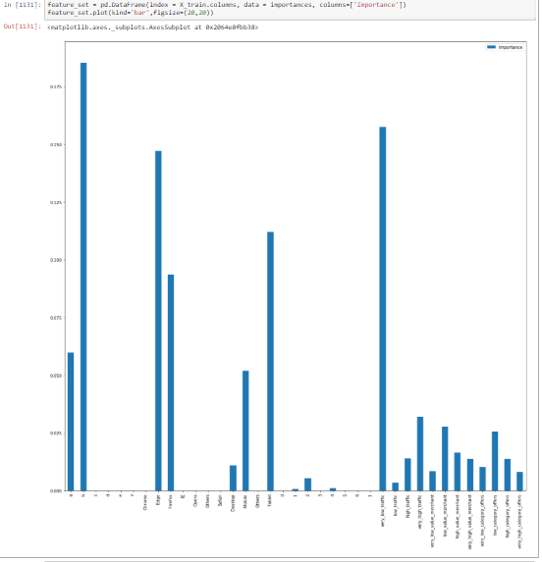
Features to be focused more on

Slide 19
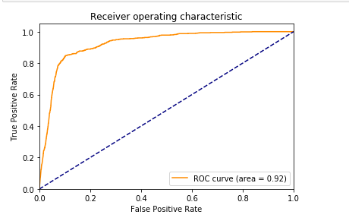
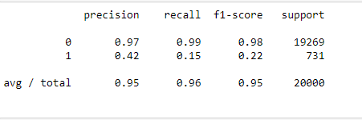
Confusion matrix

Slide 20
SUMMARY

Slide 21
OBSERVATIONS
Country B and A have the highest views
Preferred devices are mobiles and Desktops
Widely used browsers are Chrome and I.E
Most views are on Tuesdays and Thursdays
Between 10 am and 5 pm
Eventhough Country B and A have the highest views, it has low click to view ratio
RECOMMENDATIONS
Focus market should be country ‘B’, ‘A’ and ‘C’
Run ad campaigns for Chrome and IE based users for desktop and mobile
Focus time should be from 10 am to 5 pm

Slide 22
THANK YOU

